Slide 1
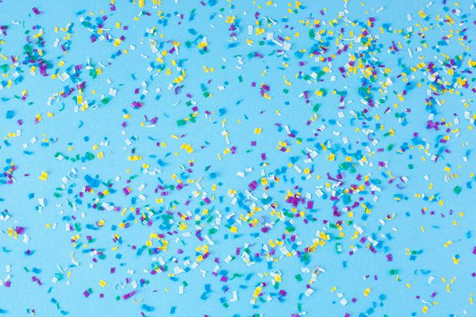
MICROPLASTICS That's one small debris by man, one giant danger for mankind

Slide 2
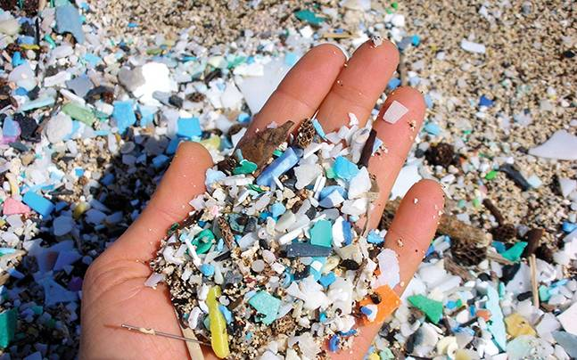
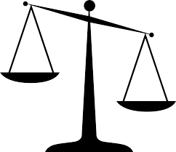
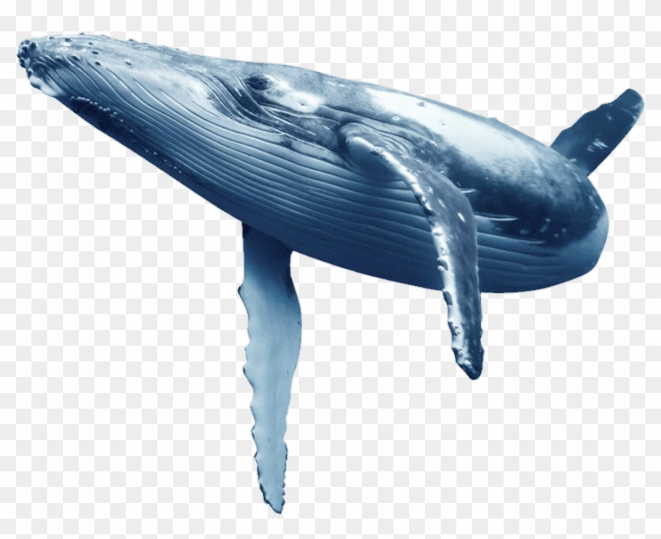
What is Microplastics?
Plastics debris less than 5mm in length
Mostly found in floating sea and oceans
In 2014, it was estimated that there were so much debris weights to 16,000 to 40,000 kg African Bush Elephants or 2,000 to 5,000 kg Blue Whales, in the world.
Recently, UN estimated that there are 500 times microplastics than stars in our galaxy.

Slide 3
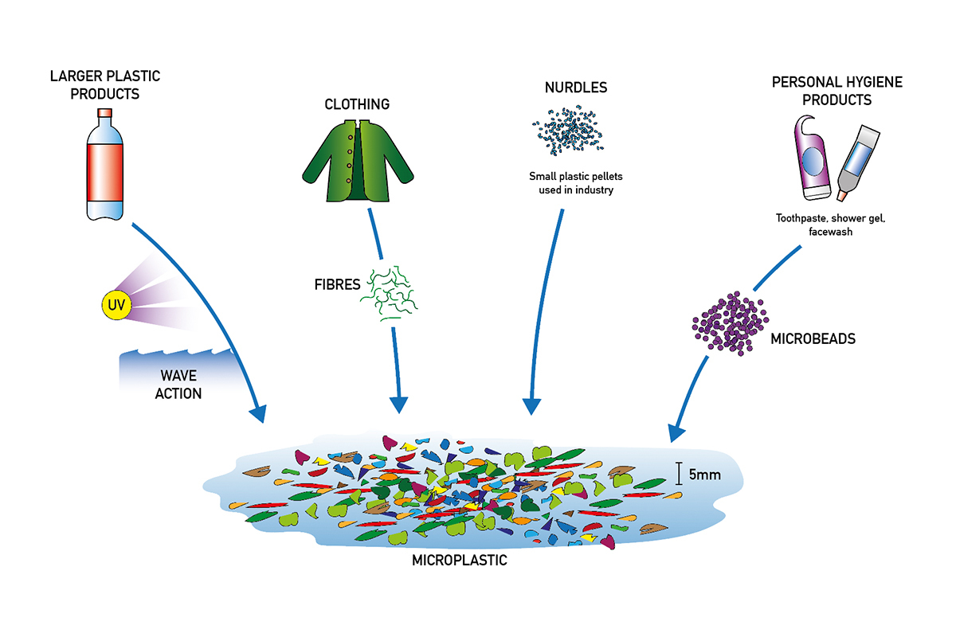
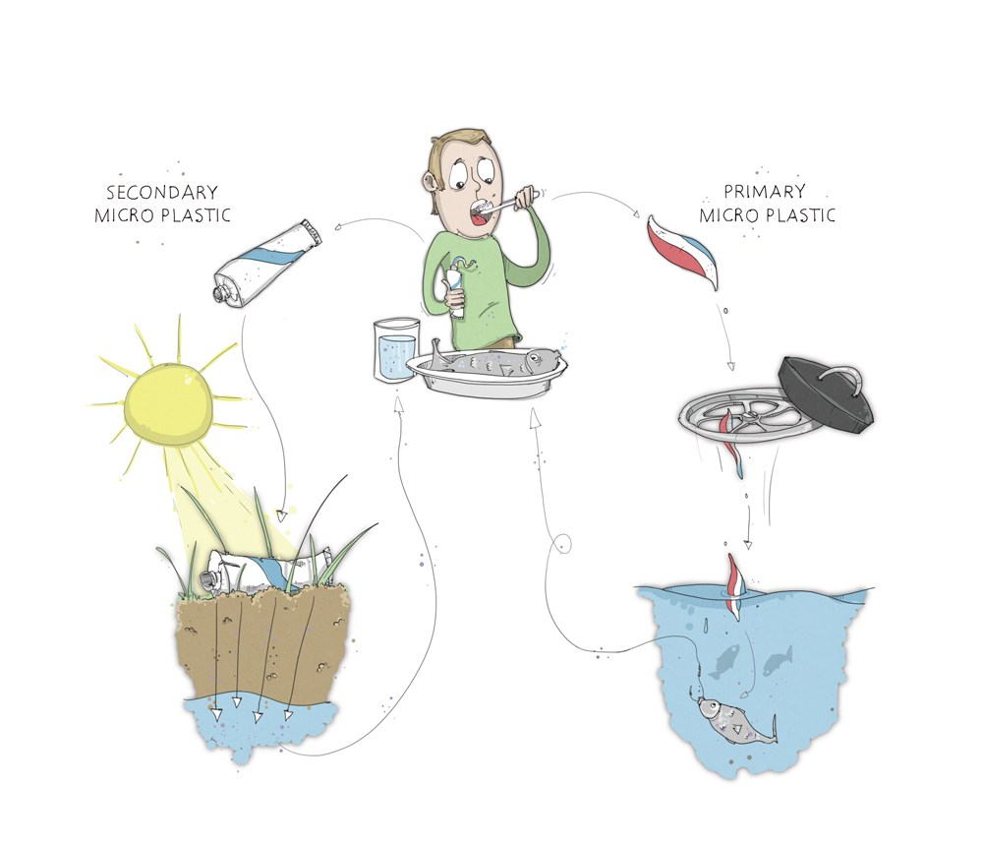
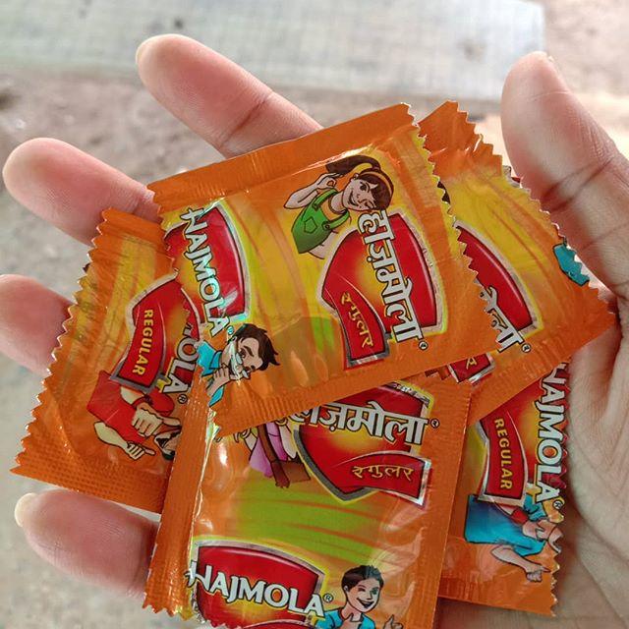
Sources and Causes
Breaking of Plastics bottles
Tearing of plastics bags
Straw pipes
Abrasion of vehicles tyres
Cosmetics products
Contaminated sea foods

Slide 4
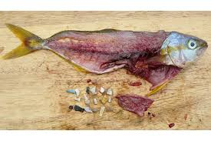
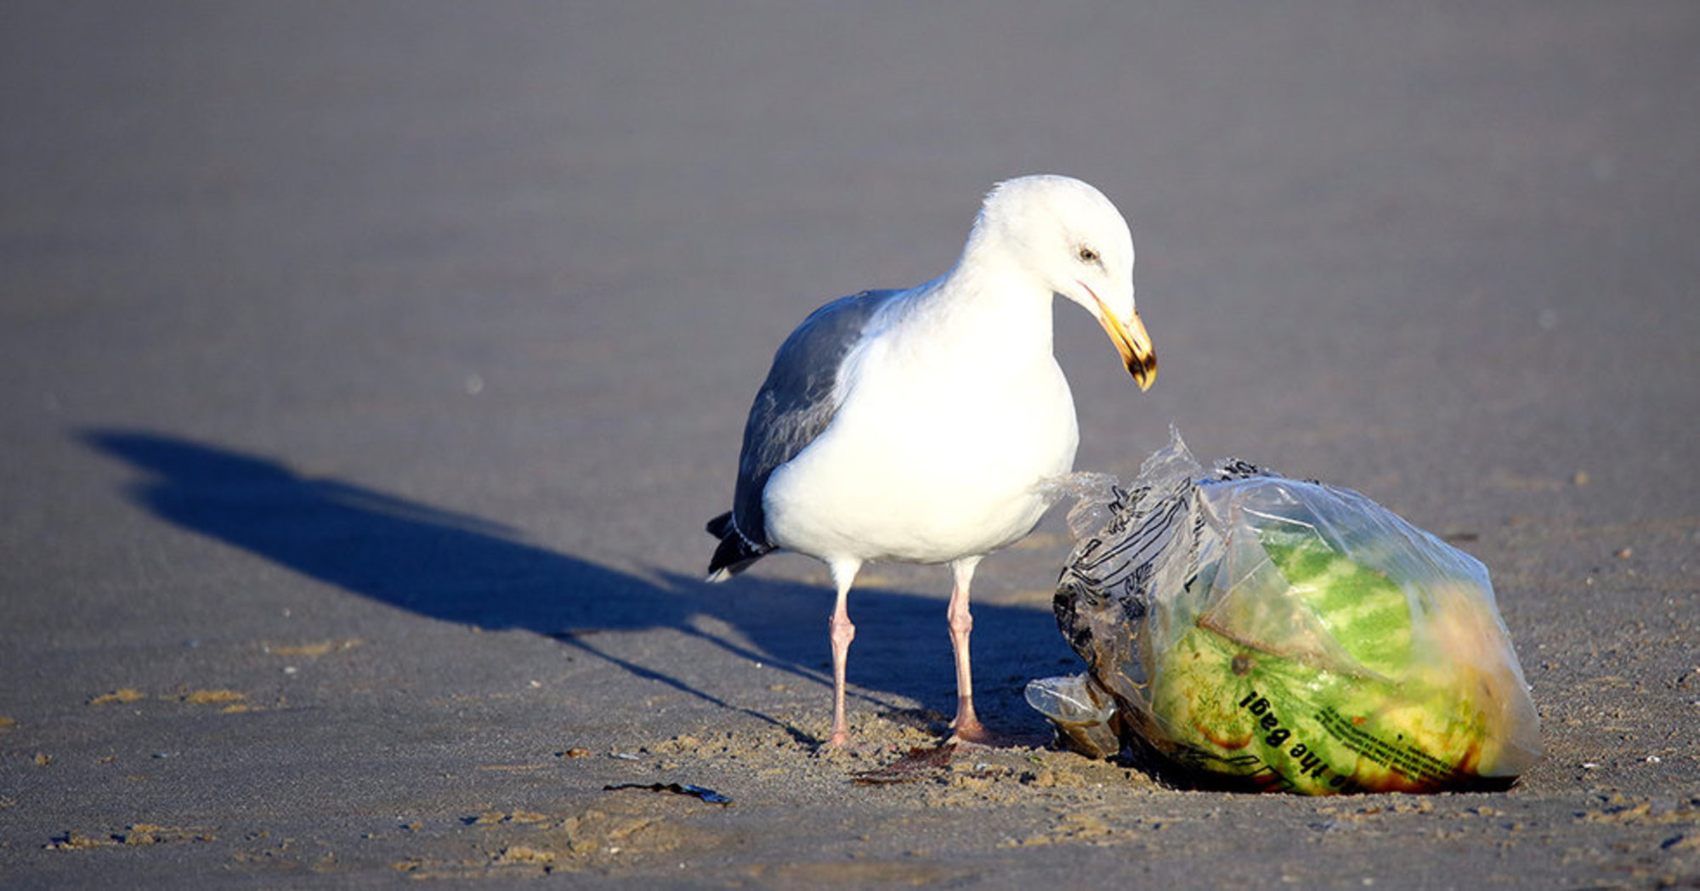
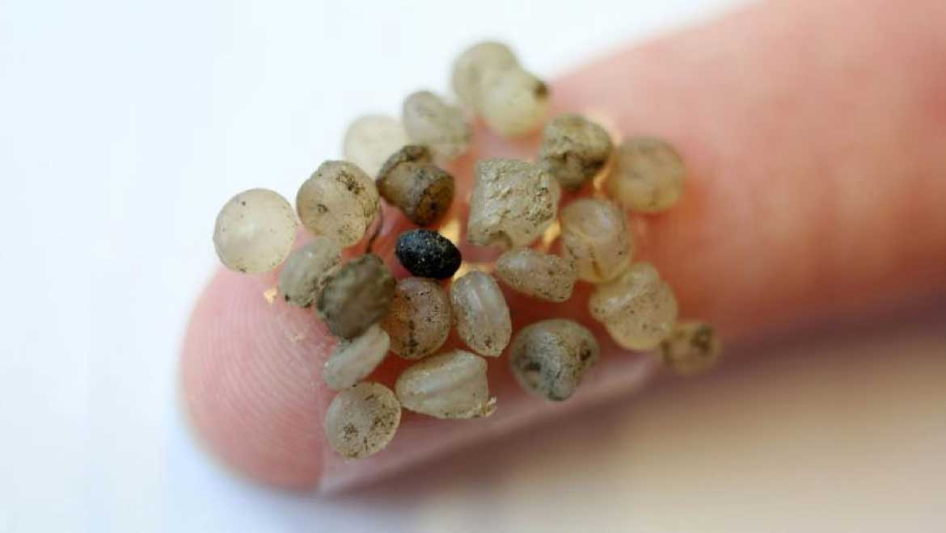
Effects of Microplastics
Mistakenly intake by fishes leads to its death
90% of Seabirds contains microplastics
It is estimated that 50% of human population contains microplastics in their stool

Slide 5
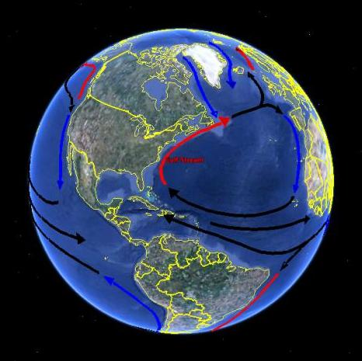
Using NASA’s data to detect a location where our mission could have the most positive effects on the ocean
Effective Regions for our mission
northwest Europe
Hawaiian Islands
Source: https://podaac.jpl.nasa.gov/OceanCurrentsCirculation
Other effective Regions from other sites are:
Bay of Bengal
South China Sea
Philippines Sea
Great Pacific Garbage Patch

Slide 6
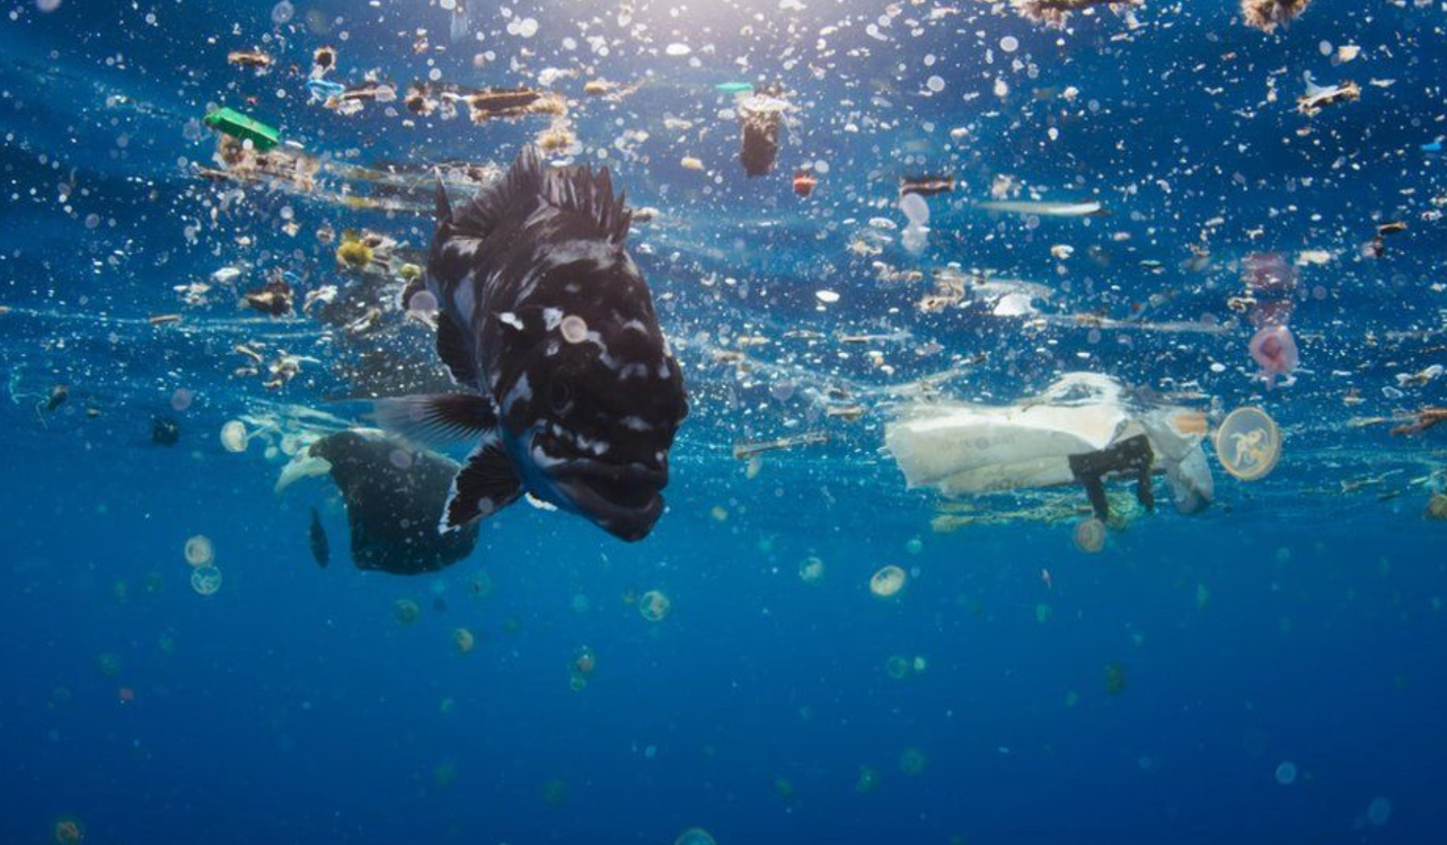
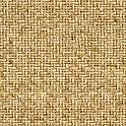
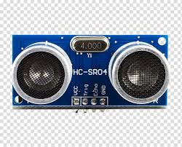

Our design to clean up microplastics
Pyramidal net with holes of 5.5mm and size 40x50cm
Long cylindrical net with multiples holes of 0.5mm and length of 250cm long
Ultrasonic sensor used to detect amount of microplastics collected
3
1
2

Slide 7
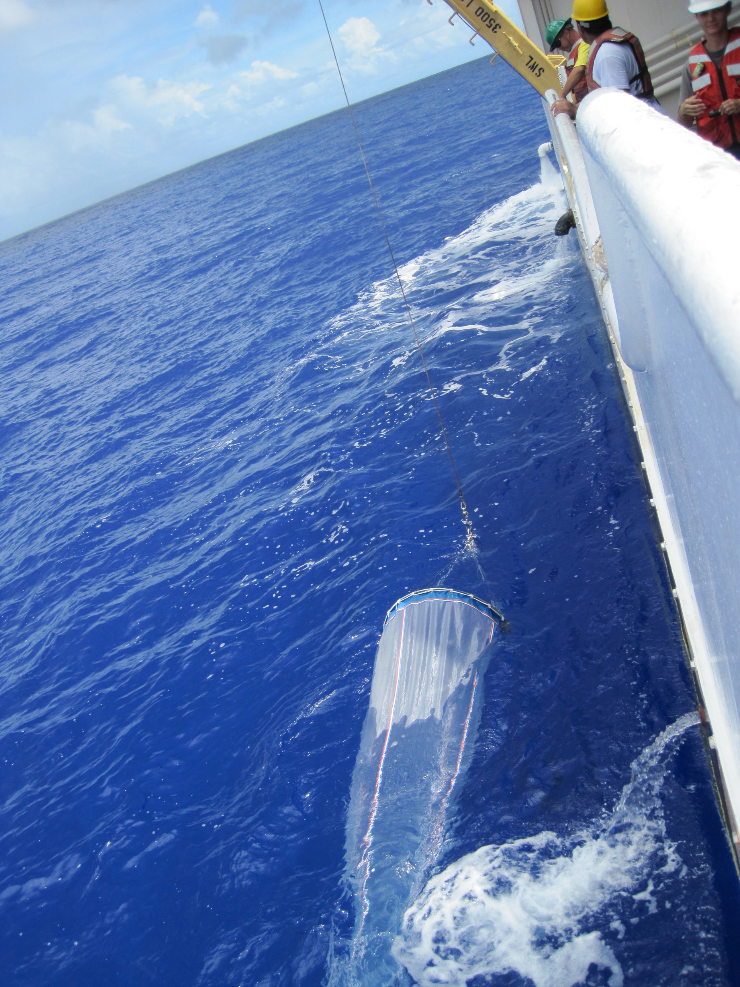
GLOBAL MISSION
We would encourage people who lives near the sea and ocean regions to use our designed in their boat or any organization to use special net provided by our net design so that we could give global impact to our mission.

Slide 8
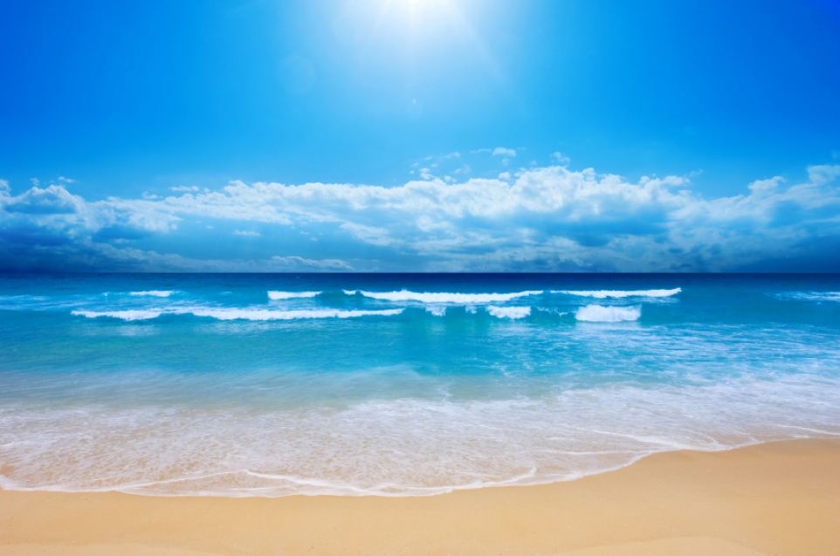
THANK YOU
NASA Space Apps Challenge 2019

Slide 10
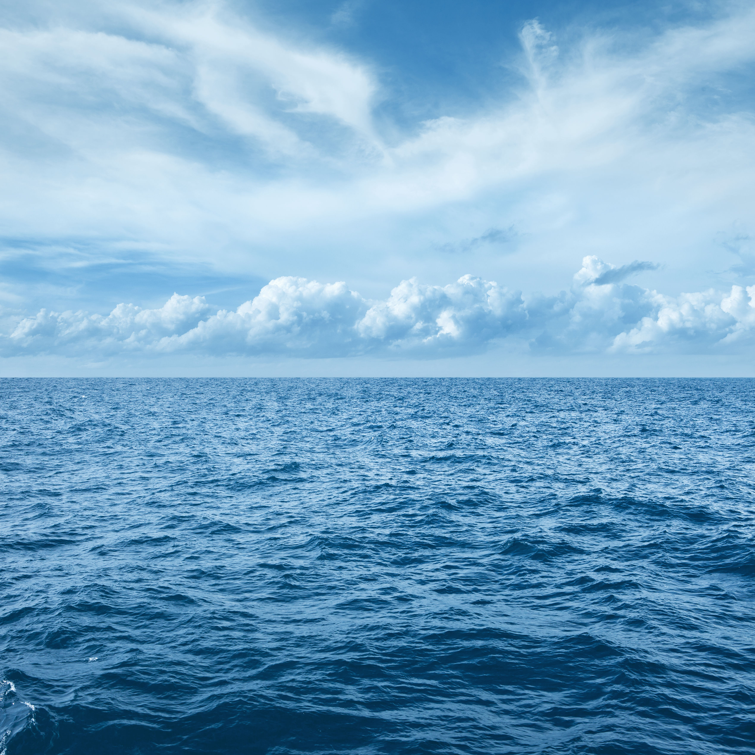
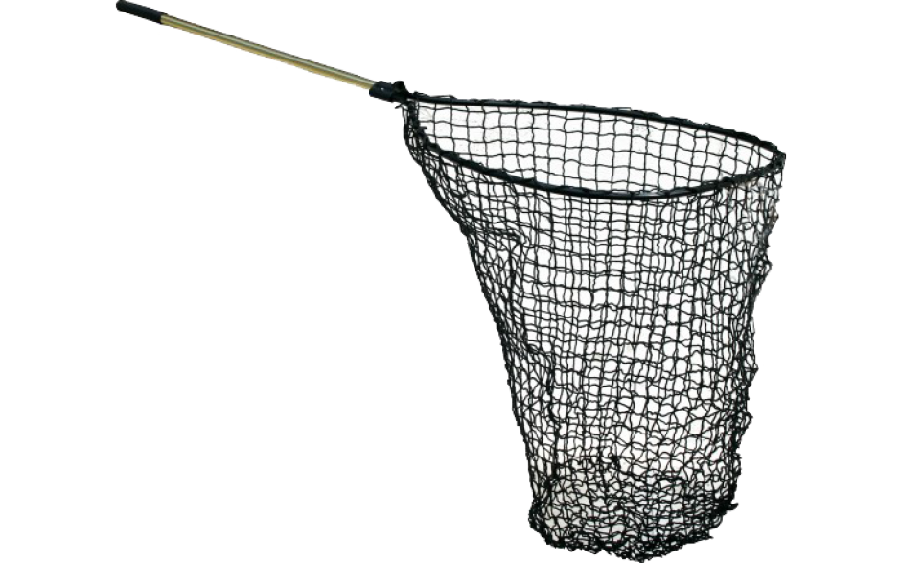
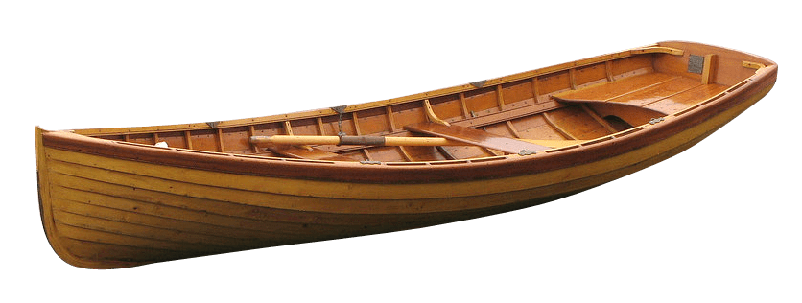
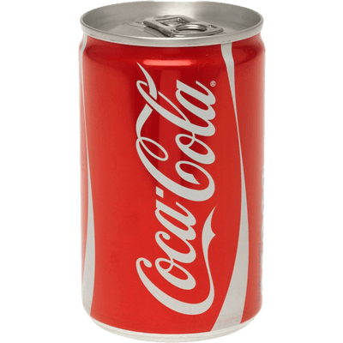

Slide 11
